Slide 1


WuW What You Want On Demand Home Service Provider
Under the guidance of Supervisor : Mr. Saroj Sharma
Presented by: Sanjana Neupane (77227222)
Module : Production Project

Slide 2
Contents
About the project
Propose of the project
Requirement for our app
Features
Waterfall model
ER Diagram
Dataflow diagram level 0
Data flow diagram level 1
Use case diagram
Feature scope of the project
conclusion

Slide 3
About the project
WuW is a home service provider that provides variety of services like plumbers, repair persons, cleaners, electricians, painters, taxi service and many more. To make it comfortable for all the users our system also provides a mobile environment which offers ease in accessing our services.
It is online platform that provide a facility to their Customers to hire trained workers online for their home services. Its aim is to provide quick and best quality services to their customers.

Slide 4
Purpose of this Project
The primary purpose of the WuW is to delivering the home services at the doorstep just by one click.
This system can be used by any authorized user intending to seek for household services through an ingenious mobile application.
To provide an authenticated and authorized login module for the users such as service seekers, service providers and the admin, by providing appropriate credentials at the time of registration.
This system solve their customer problem with this platform by taking the address and location of their customer and send their pre trained and trusted worker at customer doorstep.

Slide 5
Requirements for our App
Hardware Specification
Android Device
8 GB RAM
Software Requirements:
Android Studio, JDK, SDK
Firebase
Java, Xml, Android Virtual Machine

Slide 6
Features
Registration feature.
Login feature.
Verification through OTP facility.
Hire worker facility.
Payment Method Selection feature.
WuW assistant for address.
Customer Feedback facility.
Admin Panel to track customer request.

Slide 7
WATERFALL MODEL
Waterfall approach was first SDLC Model to be used widely in Software Engineering to ensure success of the project. In "The Waterfall" approach, the whole process of software development is divided into separate phases. In this Waterfall model, typically, the outcome of one phase acts as the input for the next phase sequentially.
The following illustration is a representation of the different phases of the Waterfall Model.

Slide 8
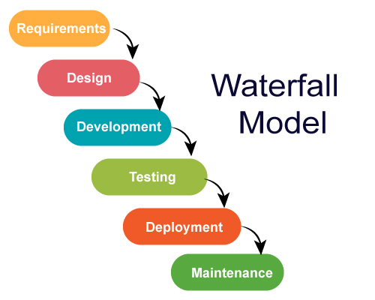
The sequential phases in Waterfall model are −
Requirement Gathering and analysis −
All possible requirements of the system to be
developed are captured in this phase and documented
in a requirement specification document.

Slide 9
System Design − The requirement specifications from first phase are studied in this phase and the system design is prepared. This system design helps in specifying hardware and system requirements and helps in defining the overall system architecture.
We created our project design demo with the help of Adobe XD and implemented that design using XML in android studio

Slide 10
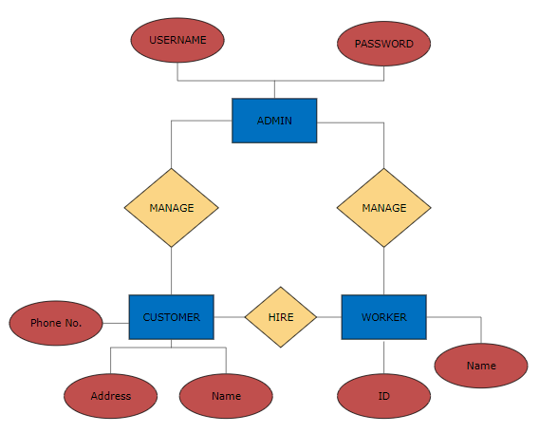
ER Diagram

Slide 11
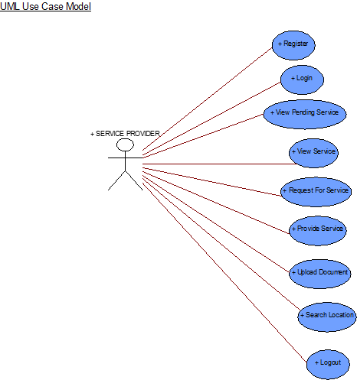
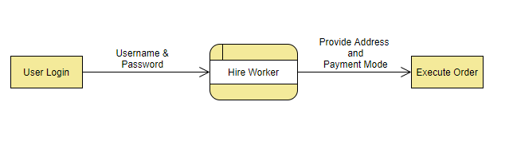
DFD – Data Flow Diagram level 0 DFD llwkwkwk

Slide 12
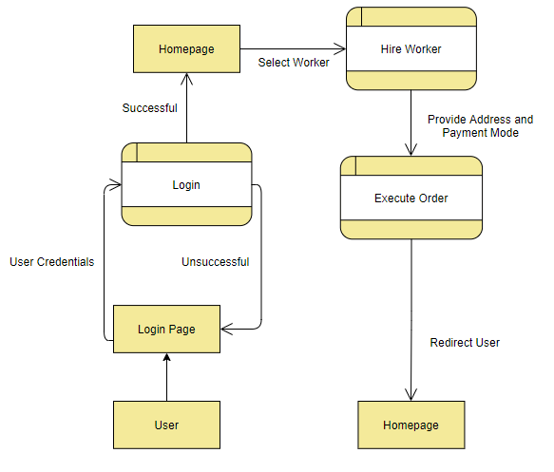
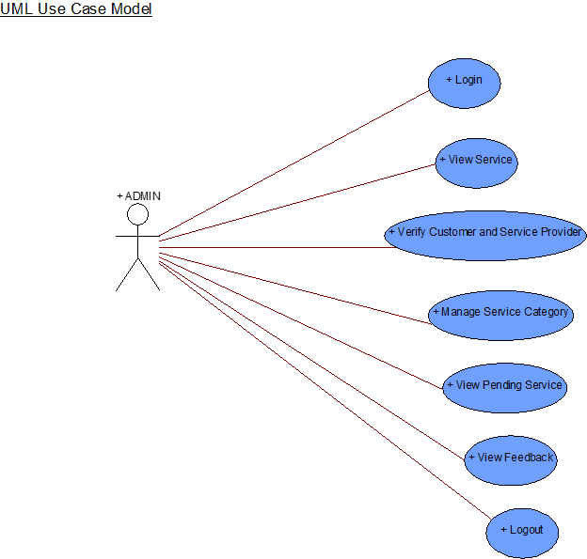
Level 1 DFD

Slide 13
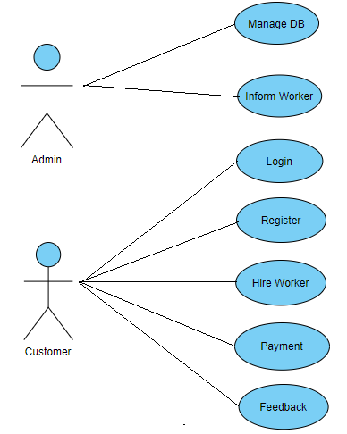
Use case diagram

Slide 14
Future Scope of the Project
WuW provides some of the home services which are most frequently used. This system accommodates the changing needs of the end user. The overall system can be designed so that its capacity can be increased in response to the further requirements for which the application provides an appropriate service overseas. Further this application can be prolonged by merely adding up the required services and additional payment systems. For example, the current system provides the following services such as Electrician, Tutor, Driver, plumber repair and service further the system can be extended as per the requirements of the user.
The system can have prolonged by adding the services such as mobile and computer repair, laundry services, catering services and many more. The discussion payment methods our system has, for example current system has no online payment gateway integrated, further it can be extended by adding the payment services for online payment using smart wallets and master cards.

Slide 15
Conclusion
In today’s fast-growing world, WOW will help in reducing the burden of the customers by taking care of their basic house needs and services. It would behave as a platform to get connected to the most reliable, trustworthy and skilled laborers for their in-house services. The framework is made such that both the customer as well as the worker (not highly educated) can easily understand and face no problem while using the app. From cleaning to pest-control, furniture and electrical works, painting, appliance and computer repair to beauty and wellness and design etc. all services will be just a click away.

